Slide 1


TRiCAM QRI Project Presentation
Understanding the Behavior of Oil Wells through Deep Learning
REU Presentation
Project Members: Michelle Yang, Akash Levy, Janette Garcia, Albert Tung

Slide 2
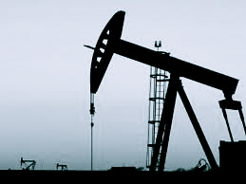
Introduction & Problem Statement
Project proposed by Quantum Reservoir Impact (QRI)
Big question:
Can deep learning find application in the petroleum industry?
Develop a proof of concept
Notes:
QRI: petroleum reservoir management company
Consult with oil companies
Mission:
Higher hydrocarbon recovery
Improve production performance
Increase profit
Reduce environmental costs
Big question posed by innovation team

Slide 3
Introduction & Problem Statement
Task: identify features in oil production data and forecast oil production rate in petroleum wells
Use machine learning to detect “events” (repairs, upgrades, other modifications to a well)
Given a well, forecast oil production for the next year
We were given a set of data from oil wells all over the world
Notes:
Data was anonymized
Included 7 different sites
Each site has hundreds of wells
Each well has data recorded each month
Data includes name of well, oil output, water output, and gas output
Data is noisy and many measurements were not taken
Each well has a different length history

Slide 4
Importance of Intelligent Computing
Current QRI approach:
Based on heuristics and statistics
Works well and delivers intended results
Has limitations: slow, limited to time series
QRI’s vision: deep learning becomes a solution for many problems the future
Fast interpretations
Different types of events identified
More complex information can be added

Slide 5
QRI’s Predictions using Hard-coded Modeling
Oil production (in standard barrels) vs. Year
Problems:
Must be manually developed
Human bias/error involved
Not easily adaptable
Less scalable for larger datasets
Event detection
Notes:
Black diamonds are events

Slide 6
QRI’s Predictions using Hard-coded Modeling
Oil production (in standard barrels) vs. Year
Problems:
Must be manually developed
Human bias/error involved
Not easily adaptable
Less scalable for larger datasets
Linear regression for events, exponential decay between events
Notes:
To do prediction they just extrapolate these curves
That might not be right

Slide 7
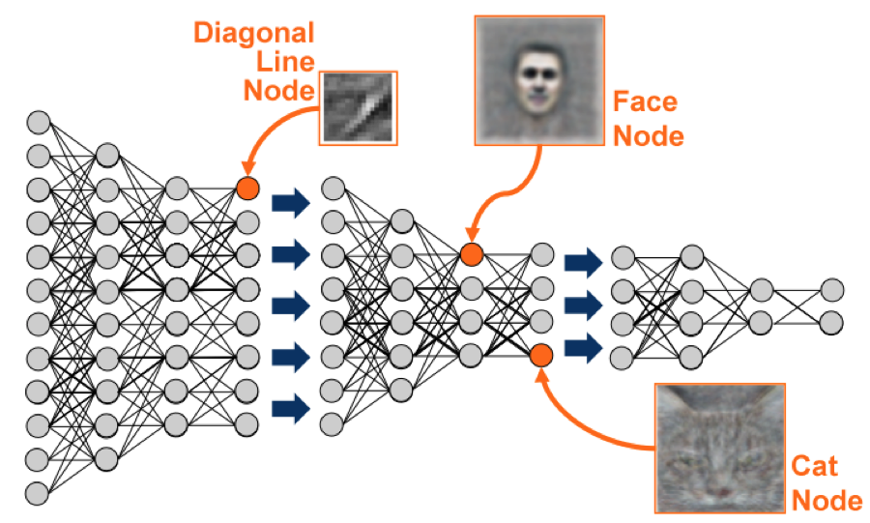
What is deep learning?
Deep learning:
Is a sophisticated form of machine learning
Applications include:
Speech recognition
Natural language processing
Face recognition
Stock market forecasting
(Google’s deep learning algorithm recognizes faces when applied to YouTube videos)
Notes:
Stock market forecasting is actually very similar to what we are trying to do

Slide 8
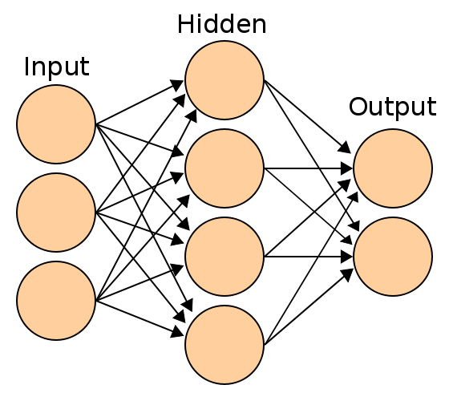
How does deep learning Work?
Deep learning involves the use of a neural network
Simplest neural network layout:
Notes:
Neural network
Mathematical model that attempts to mimic the brain’s representation of information
Deep learning usually consists of multiple hidden layers and other steps between layers
It may also involve putting constraints on the system
This is just the simplest form
We will discuss other forms later on in this presentation

Slide 9
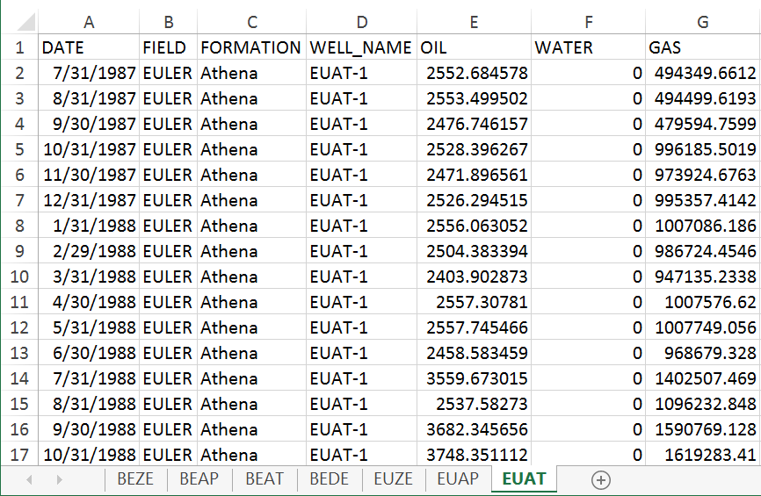
Notes:
View of the raw excel file given to us
Date: date measurement was taken; taken on the last day of the month
Field: name (anonymized) given to the site where the oil wells are located
Formation: type of oil well
Well name: first two letters of field name, first to letter of formation, and index
Oil: barrels of oil produced in one month (this is what we care about)
Water: barrels of water produced in one month
Gas: amount of gas produced in one month (this is not as important as it sounds; we just care about oil)

Slide 10
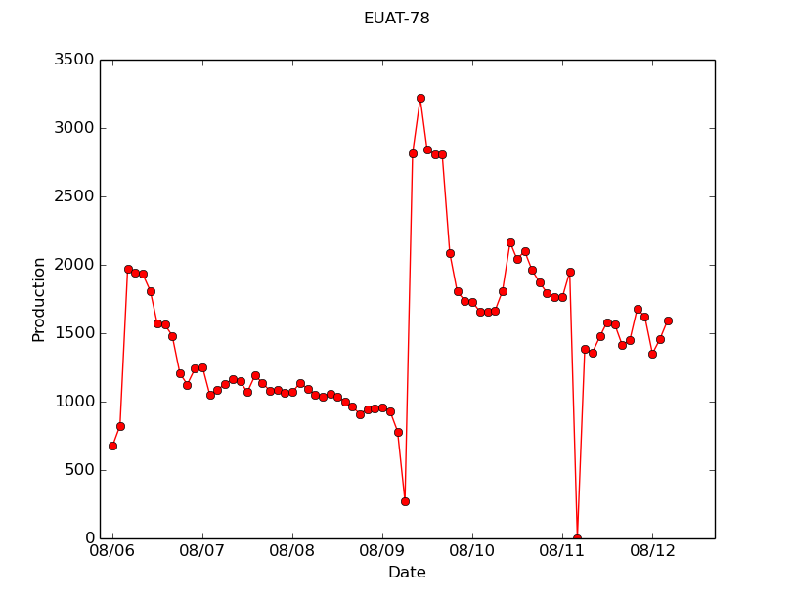
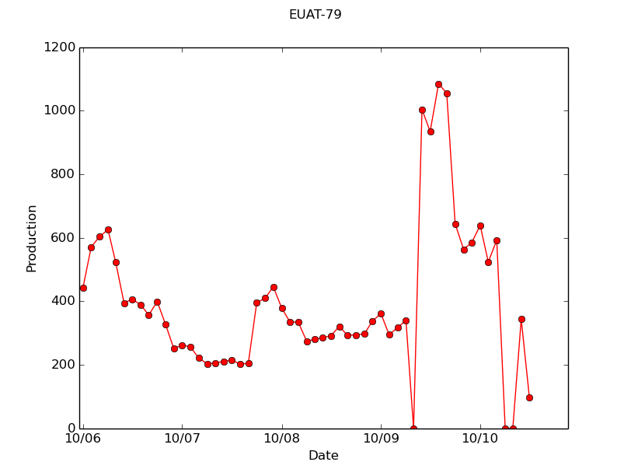
Visualization of Some Oil Well Production Data
Notes:
INSERT WELLS
Make notes about the different kinds of wells

Slide 11
Visualization of Some Oil Well Production Data
Notes:
INSERT WELLS
Make notes about the different kinds of wells

Slide 12
Visualization of Some Oil Well Production Data
Notes:
INSERT WELLS
Make notes about the different kinds of wells

Slide 13
Preprocessing From Start To Finish
Site 1
Site 3
Summary:
Each site has multiple wells
Each well has a different amount of data in it
Sample data from each well every month and remove zeros
Turn wells into chunks
Normalize chunks
Split into training, validation, and testing sets
Well 1
Well 2
Well 3
Well 1
Well 2
…
…
Site 2
…
Well 1
Well 2
Well 1
Well 2
Well 3
…
…
Notes:
This is what our data set is from a top view

Slide 14
Preprocessing From Start To Finish
Well before: months and zeros
Well after: month index and no zeros
Summary:
Each site has multiple wells
Each well has a different amount of data in it
Sample data from each well every month and remove zeros
Turn wells into chunks
Normalize chunks
Split into training, validation, and testing sets
Well 1
Notes:
These points are almost always a result of something gone wrong:
Oil well was turned off for repair
Oil well was turned off for lack of profit
Measurement was not taken
These are points we do not want to include in any of our datasets

Slide 15
Preprocessing From Start To Finish
Make a graph with sliding window and chunks being created from that graph below
Well 1
Summary:
Each site has multiple wells
Each well has a different amount of data in it
Sample data from each well every month and remove zeros
Turn wells into chunks
Normalize chunks
Split into training, validation, and testing sets
Chunk1
Chunk 2
Chunk 3
Notes:
Sliding window approach
Some machine learning algorithms only take fixed size input
Another advantage: ensures that enough data is being trained on
We used:
Input size: 48 months (4 yrs.)
Output size: 12 months (1 yrs.)
Step size: 6 months
Instruct machine: “given this input, you should produce this output”

Slide 16
Preprocessing From Start To Finish
Chunk1
Summary:
Each site has multiple wells
Each well has a different amount of data in it
Sample data from each well every month and remove zeros
Turn wells into chunks
Normalize chunks
Split into training, validation, and testing sets
Before: unnormalized chunk
After: normalized chunk
Notes:
Subtract mean, divide by standard deviation
Ensures that chunks are centered at 0 and equally distributed
Need to ensure that you normalize with respect to the input only!
We forgot to do that and got overly-optimistic results

Slide 17
Preprocessing From Start To Finish
Summary:
Each site has multiple wells
Each well has a different amount of data in it
Sample data from each well every month and remove zeros
Turn wells into chunks
Normalize chunks
Split into training, validation, and testing sets
Well 1
Training set
Chunk 1
Chunk 2
Chunk 3
Chunks from well 1
…
…
Well 2
Validation set
Chunk 1
Chunk 2
Chunk 3
Chunks from well 2
…
…
Well 3
Testing set
Chunk 1
Chunk 2
Chunk 3
Chunks from well 3
…
…
Notes:
Training dataset
Examples shown to the network
Validation dataset
Different set of examples to determine when to stop training
Testing dataset
Examples to evaluate the performance of the network
Used a 6:1:1 ratio to split the wells
Did splitting randomly from sites

Slide 18
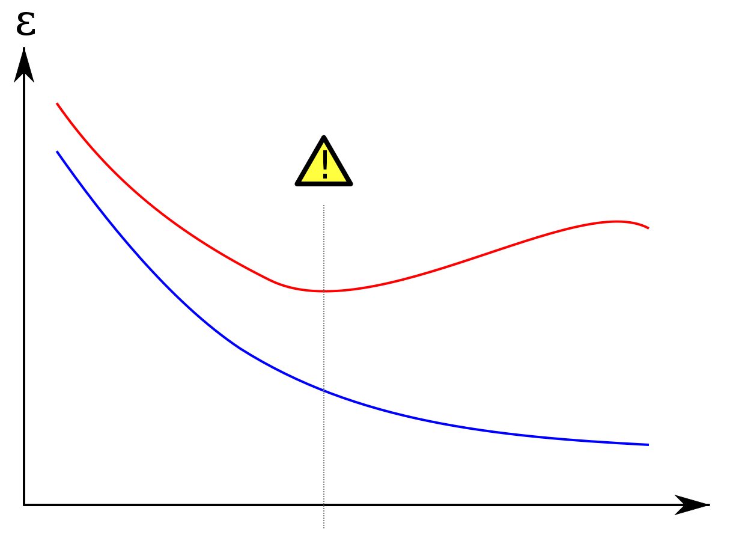
Why Three Datasets are Needed
Error
Validation Set
Overtraining: after a certain number of training steps, you continue to get better predictions on data the network has seen but not for on new data
Training Set
Training Steps
Notes:
Works less well on new data
Stop training at ! mark
Evaluate network on testing set, which hasn’t influenced training at all
Validation set HAS influenced training because it determined when to stop

Slide 19
Different Machine learning architectures Tested
Name: Baseline (0-layer fully-connected)
Description: Fully connected network with zero hidden layers. Essentially performs matrix multiplication with the input and adds a bias to produce the output.
Training time: 4.2 s
Test set loss: 0.845515
Time ranking: 1/16
Accuracy ranking: 14/16
Notes:
How is this able to do prediction?
Regression towards mean; results from us helping the algorithm by normalizing.
Fastest because only performing matrix multiplication

Slide 20
Different Machine learning architectures Tested
Name: Fully Connected1-layer
Description: Fully connected network with one hidden layer (using rectified linear units activation function) and 0.5 dropout between hidden layer and output.
Training time: 9.5 s
Test set loss: 0.848628
Time ranking: 2/16
Accuracy ranking: 16/16

Slide 21
Different Machine learning architectures Tested
Name: Convolutional1-layer
Description: Evaluates the convolution of multiple filters with input and connects result to hidden layer (through ReLU). Run with 13 kernels, 100 filters. Performs significantly faster on GPU than CPU.
Training time: 142.2 s
Test set loss: 0.846481
Time ranking: 9/16
Accuracy ranking: 15/16
Notes:
Probably will work better with max-pooling and multiple layers
Try with different filter sizes too

Slide 22
Different Machine learning architectures Tested
Name: Simple RNN1-layer sigmoid, 1-layer ReLU, 3-layers sigmoid, 3-layers ReLU
Description: Fully connected network where layers’ outputs are fed back in as inputs (with sigmoid activation function)
Training time: 95.6 s, 51.5 s, 401.9 s, 106.1 s
Test set loss: 0.839948, 0.837879, 0.839281, 0.838986
Time ranking: 5/16, 4/16, 16/16, 6/16
Accuracy ranking: 8/16, 13/16, 11/16, 10/16

Slide 23
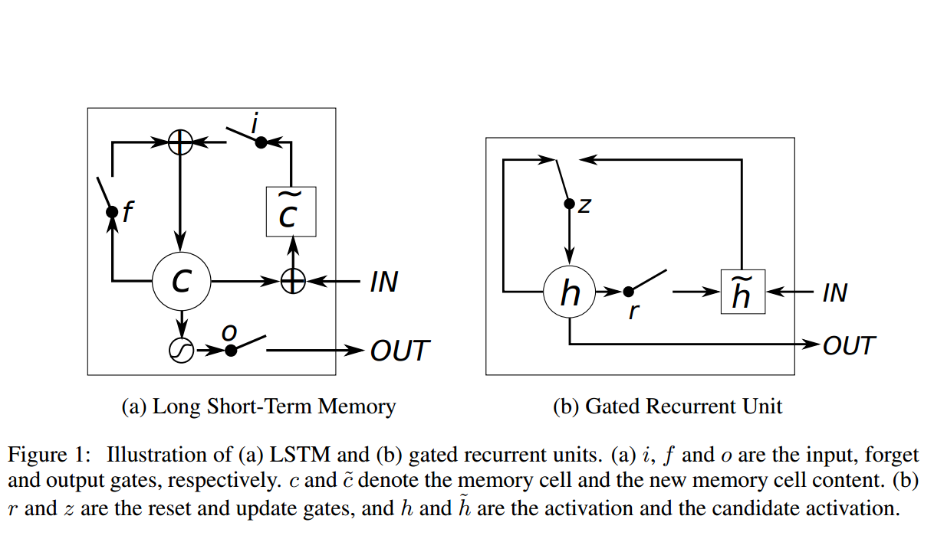
Different Machine learning architectures Tested
Name: Gated Recurrent Unit (1-layer, 1-layer ReLU)
Description: Same as simple recurrent but uses the reset and update gates as additional parameters when feeding past outputs backwards.
Training time: 284.6 s, 144.8 s
Test set loss: 0.836572, 0.832880
Time ranking: 14/16, 10/16
Accuracy ranking: 4/16, 1/16

Slide 24
Different Machine learning architectures Tested
Name: Long Short-Term Memory (1-layer)
Description: Same as simple recurrent using hyperbolic tangent activation function but uses the input, output, and forget gates as additional parameters when feeding past outputs backwards.
Training time: 326.5 s
Test set loss: 0.836652
Time ranking: 15/16
Accuracy ranking: 5/16

Slide 25
Different Machine learning architectures Tested
Name: MUT1, MUT2, MUT3, MUT1 ReLU, MUT2 ReLU, MUT3, ReLU
Description: Optimized versions similar to GRU and LSTM (with optimized biases/layer sizes found through hyper-parameter optimization)
Training time: 267.8 s, 197.5 s, 137.2 s, 167.6 s, 109.0 s, 45.7 s
Test set loss: 0.836049, 0.835410, 0.837395, 0.838955, 0.837153, 0.839637
Time ranking: 13/16, 12/16, 8/16, 11/16, 7/16, 3/16
Accuracy ranking: 3/16, 2/16, 7/16, 9/16, 6/16, 12/16

Slide 26
Visualization of Some Oil Well Predictions
Notes:
INSERT WELLS
Make notes about the different kinds of wells

Slide 27
Visualization of Some Oil Well Predictions
Notes:
INSERT WELLS
Make notes about the different kinds of wells

Slide 28
Visualization of Some Oil Well Predictions
Notes:
INSERT WELLS
Make notes about the different kinds of wells

Slide 29
Visualization of Some Oil Well Predictions
Notes:
INSERT WELLS
Make notes about the different kinds of wells

Slide 30
Visualization of Some Oil Well Predictions
Notes:
INSERT WELLS
Make notes about the different kinds of wells

Slide 31
Visualization of Some Oil Well Predictions
Notes:
INSERT WELLS
Make notes about the different kinds of wells

Slide 32
Last Steps
Scatterplot showing performance of each network
Hyper-parameter optimization using clusters
Test concatenated one-month output for RNNs
Add post-processor to renormalize predictions
Write paper describing results
Notes:
Optimize various settings within the machine learning process
Batch size, learning rate, number of hidden layers, neurons per hidden layer etc.

Slide 33
Future Directions
Further hyper-parameter optimization
Explore other neural network implementations:
Hierarchical Temporal Memory (HTM): very closely resembles the brain, was recommended to us by QRI
Incorporate water and gas data inputs to aid predictions
Train differently on different kinds of oil wells
Add events as an input to aid predictions
Notes:
Events: repairs, upgrades, other modifications to a well

Slide 34
Thank you!
Questions?
We would like to extend our sincerest thanks to the directors of the Harvard SEAS REU, the TRiCAM coordinators, QRI, and our wonderful mentor Verena who enabled this project to happen.
Notes:
Still left to do:
Add post-processor
Hyper-parameter optimization using clusters
Write paper
Test one-month output for RNNs (with and without dynamic input length)
Read On Intelligence and try HTM

